Slide 1



Stay Safe Online &
Spot Scams
A part of the Lifelong Learning Festival 2020

Slide 2


Today’s Topics
The Numbers
Online Safety
Preventing Scams

Slide 3
Intro
About me – Paul:
  IT Professional for 18 Years, IT user for 30 years
  Love to teach computer skills
  Hates getting scam calls

Slide 4
The Numbers
How much are we losing to scams?

Slide 5
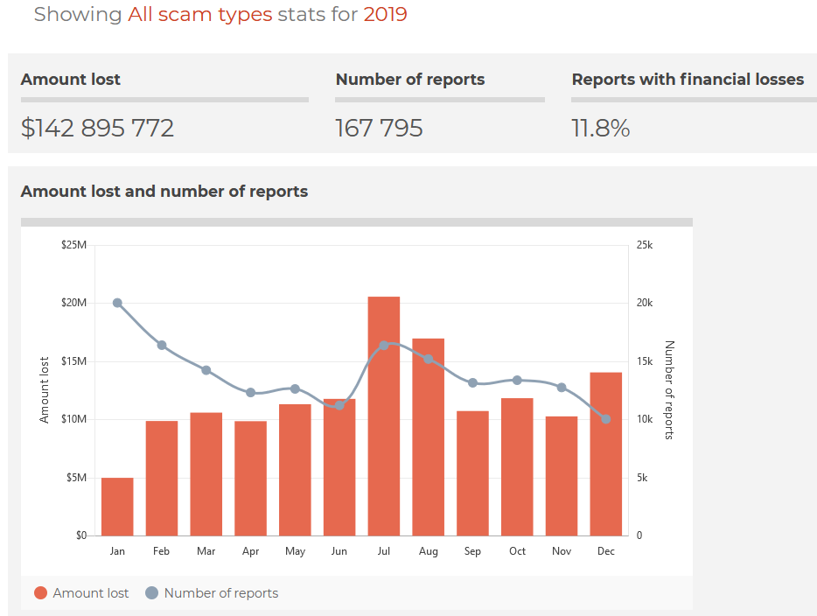
The Numbers
Question…
For all of 2019, how much money was know to have been lost through scams in Australia alone?
A. Less than $10 Million?
or
B. More than $10 Million?
$61.8M from Investment Scams
$26.6M from Dating and Romance
$10.1M from False Billing
With Hacking, Online Scams, Remote Access and Identity Theft filling most of the rest.

Slide 6
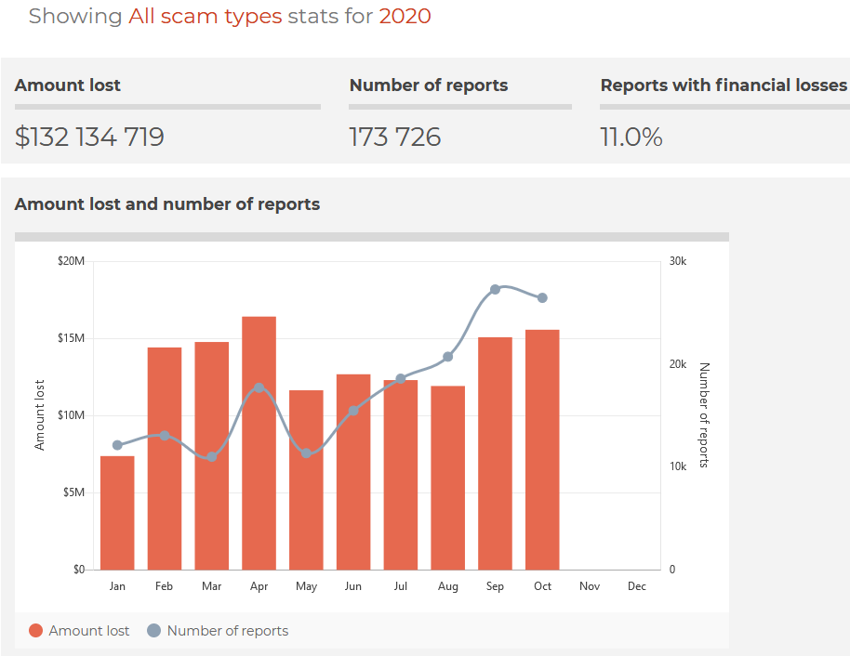
The Numbers
$49.2M from Investment Scams
$31.1M from Dating and Romance
$10.2M from Threats to life or arrest
With False Billing, Remote Access and Classified scams filling out most of the rest.

Slide 7
Type of Threats
The three types of threats and what to do about each

Slide 8





Types of Threats
The three main types of threats to your computer are;
Physical
  If someone gains physical access to your computer they can do what every they want
Physical
Network
Executable
2) Network
  Online connection to bad sites, clicking on links in emails and opening attachments
2) Executables
  Opening those attachments or downloading things that are harmful

Slide 9
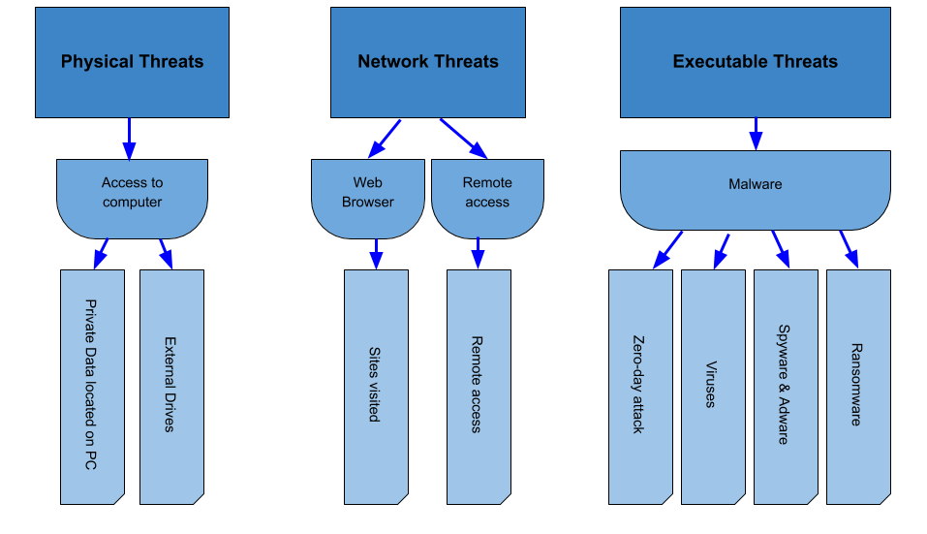
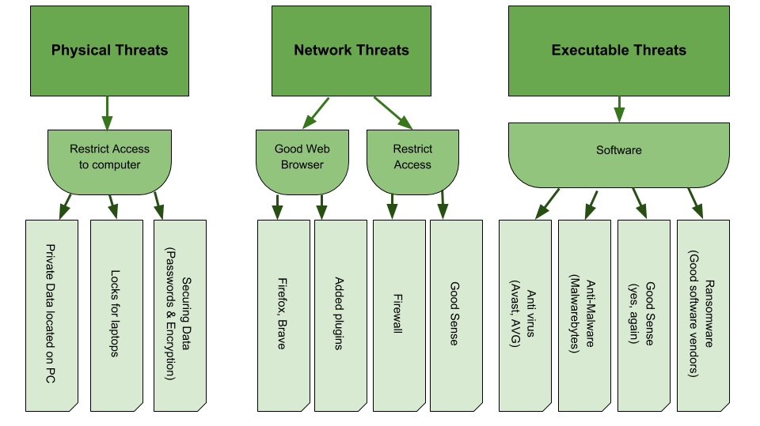
Types of Threats
Source
Defence
Physical
Network
Executable

Slide 10
Types of Threats
Source
Defence
Physical
Network
Executable

Slide 11
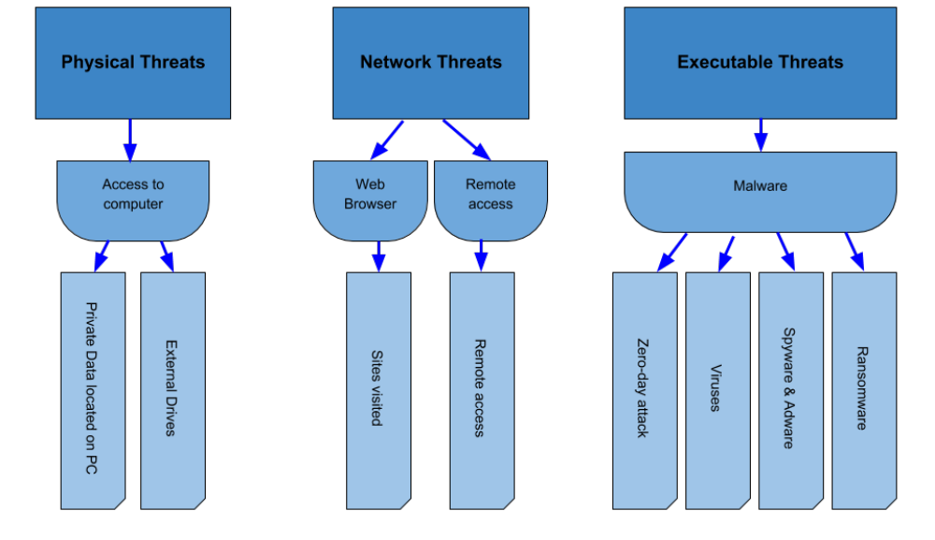
Types of Threats
Source
Defence
Physical
Network
Executable

Slide 12
Lines of Defence
When it comes to network and executable threats, I like to think in terms of ‘lines of defence’ as illustrated below.
1st line - Brain, critical thinking
  2nd line - Browser (default setting and plugins)
    3rd line - Software to prevent attacks
--------------------------Attack has made it through--------------------------
      4th line - Software to recover from attacks
        5th line - Backups of data (restore from backup)
          6th line - Clean slate, start from scratch

Slide 13
Preventing Problems Can be Easy!
Checklist for making things better
Knowledge
Critical Thinking
Good Browser
Some plugins
Free Anti Virus and Anti Malware

Slide 14
Knowledge and Critical Thinking
Resources;
Scamwatch https://www.scamwatch.gov.au/
ACCC’s “Little book of Scams https://www.accc.gov.au/publications/the-little-black-book-of-scams

Slide 15


Ease of Use vs. Security
Less Security
Perfect
Easy to
use
Hard to
use
More Security

Slide 16



A Good Browser
Fierfox
Brave
Google Chrome

Slide 17


Plugins
uBlock Orign
Adblocker Ultimate

Slide 18


Anti Virus & Anti Malware
ClamWin
Malwarebytes

Slide 19
Prevent (Phone) Fraud
What to watch out for and what to do

Slide 20
Nine Defences Against Phone Scammers and Telemarketers
1. Don’t Advertise
2. Sign-up for Silence
3. Adios Anonymous
4. Block the Bums
5. Pay for Silence
6. Can’t come to the phone, Please Leave a Message
7. Punt the Pause
8. Pass on the Push
9. Dive into the Directory

Slide 21
Tactics and Strategy to Avoid Being a Phone Fraud Victim
Yank the Yes
Oops, Wrong Name
  Oh, My Headset is a Mess
Smishing
You’ve Won!
Grandkid Scam
  They Got a Name, Now What?
Keep the Lights On
Spoofing
The Pop-Up
ATO Scams
Please Help
Can We Help You?

Slide 22
Five Universal Phone Fraud Prevention Truths
1. You do NOT have to answer your phone.
2. There is no law against hanging up on a phone fraud scammer.
3. Don’t talk to them. Just hang up.
4. If you don’t have a mobile phone and instead use a home landline you aren't safe
5. Do not mess around with the scammers.

Slide 23

Thank You!
Files of todays class can be found at:
www. hobstar.io/training/scams
Contact me, Paul, on:
hobstar@protonmail.com

